Slide 1
Rain-on-snow
Progress update
Vincenzo Coia · ESA progress meeting · 15 September 2026
Notes:
Four parts: software updates, rain-on-snow findings, statistical developments, and where we are on the timeline.

Slide 2
UPDATES
probaverse: new releases on CRAN
distionary and distplyr both have new versions out.
The graft machinery is now published in the packages, rather than living as loose code in the project repository.
Supports
A distribution knows where it lives, not only what it evaluates to. Now complete.
Discrete parts
Algorithms anticipate distributions with a discrete component, and are faster for it.
Hard graft
Supported in distplyr. The smooth graft comes later in this deck.
JOSS
Software paper submitted.
Notes:
Why supports matter: grafting a tail onto an empirical body joins something that stops dead to something that runs forever. Without a support, the algorithms cannot tell an impossible value from an unlikely one.

Slide 3
SECTION ONE
Rain-on-snow
Which mix of rain and snowmelt sits behind a T-year runoff event.
1

Slide 4
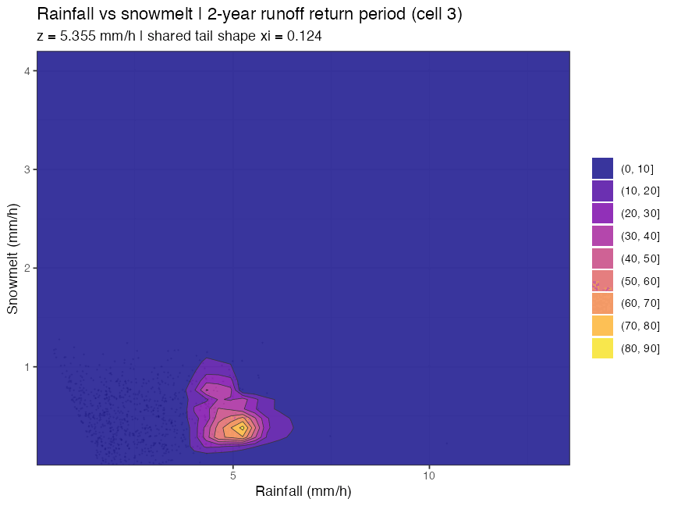
RAIN-ON-SNOW
Dials of risk
Rain and snowmelt behind the T-year runoff event, as T grows. Cell 3.
What to watch
As T grows, the likeliest mix moves towards rain alone: more rainfall, with an ordinary snowmelt.
Not yet reliable.
Key problems in the distributional learning model sit under this picture: the learned conditionals stop where the data stop, so the rare-event end is the least trustworthy part.
Notes:
At T = 2 the likeliest mix is a 2.1-year rainfall with a 0.3-year snowmelt; at T = 200, a 9.4-year rainfall with a 0.24-year snowmelt. Rainfall explains over 90% of the variation in runoff at peaks in this cell. The animation plays in slideshow mode.

Slide 5
RAIN-ON-SNOW
The next question
Condition on the state of the snowpack, not only on what is falling on it.
For a T-year runoff event, with a given amount of water available in the snowpack, how much rain is enough to trigger it?
The new driver
Water available in the snowpack, which is closely tied to snow wetness.
Where ESA comes in
Snow wetness is observed from space: the natural moment to bring in an ESA data product.
What is ready
The analysis pipeline now takes any driver and answers this question directly.
Notes:
The pipeline was restructured so each analysis is a choice of drivers, a learning model, and a question. A first pass with snowmelt standing in for available water already runs; the forest used there cannot yet resolve events rarer than about 2 years, which is the same tail problem as the previous slide.

Slide 6
SECTION TWO
Statistical developments
Tail estimation now pays off. The learning model has two new challenges.
2

Slide 7
TAIL ESTIMATION
The smooth graft, revisited
Where we left off
The smooth graft on its own did not look like it was worth anything.
A gentler handover of the same tail.
Where we are now
Combined with a new composite estimation method, built on expectiles, it improves on classical tail estimation.
The composite weight doubles as the handover.
The composite estimator: an expectile loss integrated over levels, weighted towards the tail
S(θ) = Σᵢ ∫₀¹ w(p) · | p − 1(yᵢ < E(p|θ)) | · (yᵢ − E(p|θ))² dp
Notes:
E is the family's expectile function. The weight w(p) does the work; the useful range puts it low, p0 around 0.5 to 0.8, not 0.95.

Slide 8
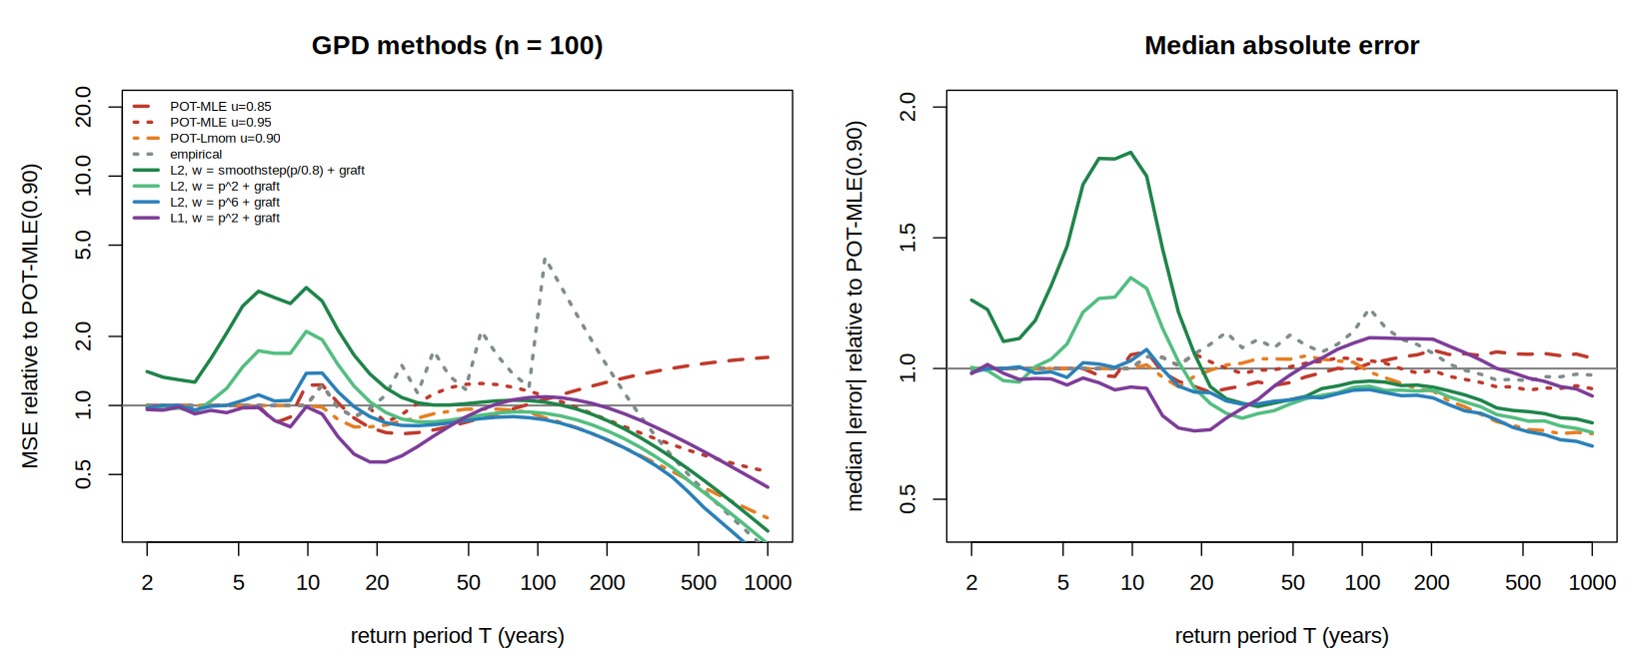
TAIL ESTIMATION
Against what practitioners do
Composite fits: smooth grafted. Reference: POT-MLE at the 90th percentile, hard grafted.
Composite L2, w = p⁶, smooth grafted: MSE ratio 0.86 at T = 50 falling to 0.21 at T = 1000; closer on 77% of datasets.
Notes:
Threshold choice dominates the competitor: POT-MLE at 0.85 / 0.90 / 0.95 gives MSE in the ratio 1.62 : 1.00 : 0.52 at T = 1000, a threefold spread from a choice the data cannot make. The composite estimator has no threshold; the weight plays that role, smoothly.

Slide 9
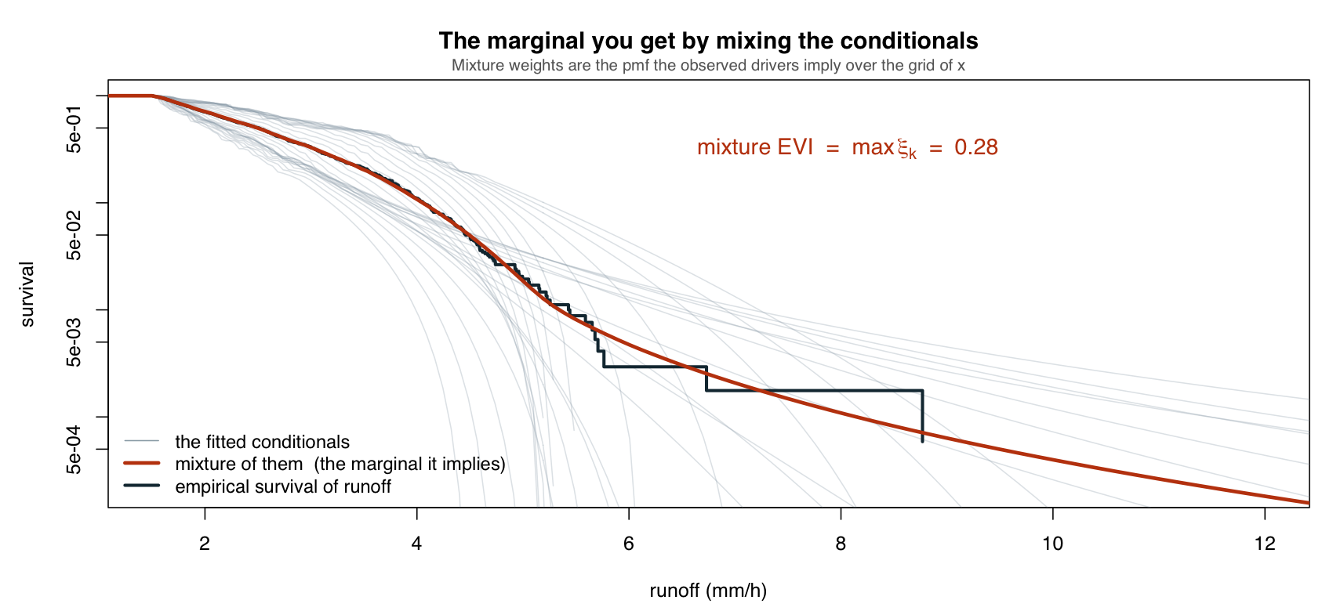
DISTRIBUTIONAL LEARNING
Challenge 1: the marginal of runoff
Averaging the learned conditionals over the drivers is ill-conditioned, for two reasons.
(i) The maximum of noise
The mixture's tail index is the largest tail index among the conditionals: the maximum of a set of noisy estimates.
(ii) The jump needs extrapolation
The marginal EVI is often strictly larger than every conditional EVI. Reaching it takes predictions far out in predictor space, and machine learning cannot go there.
Learning stops at the data.
Notes:
Point (ii) is from Coia et al. (2020): the marginal EVI is always at least the largest conditional EVI, strictly so for many copulas. Closing that gap needs the conditionals to hold indefinitely into the tail of x.

Slide 10
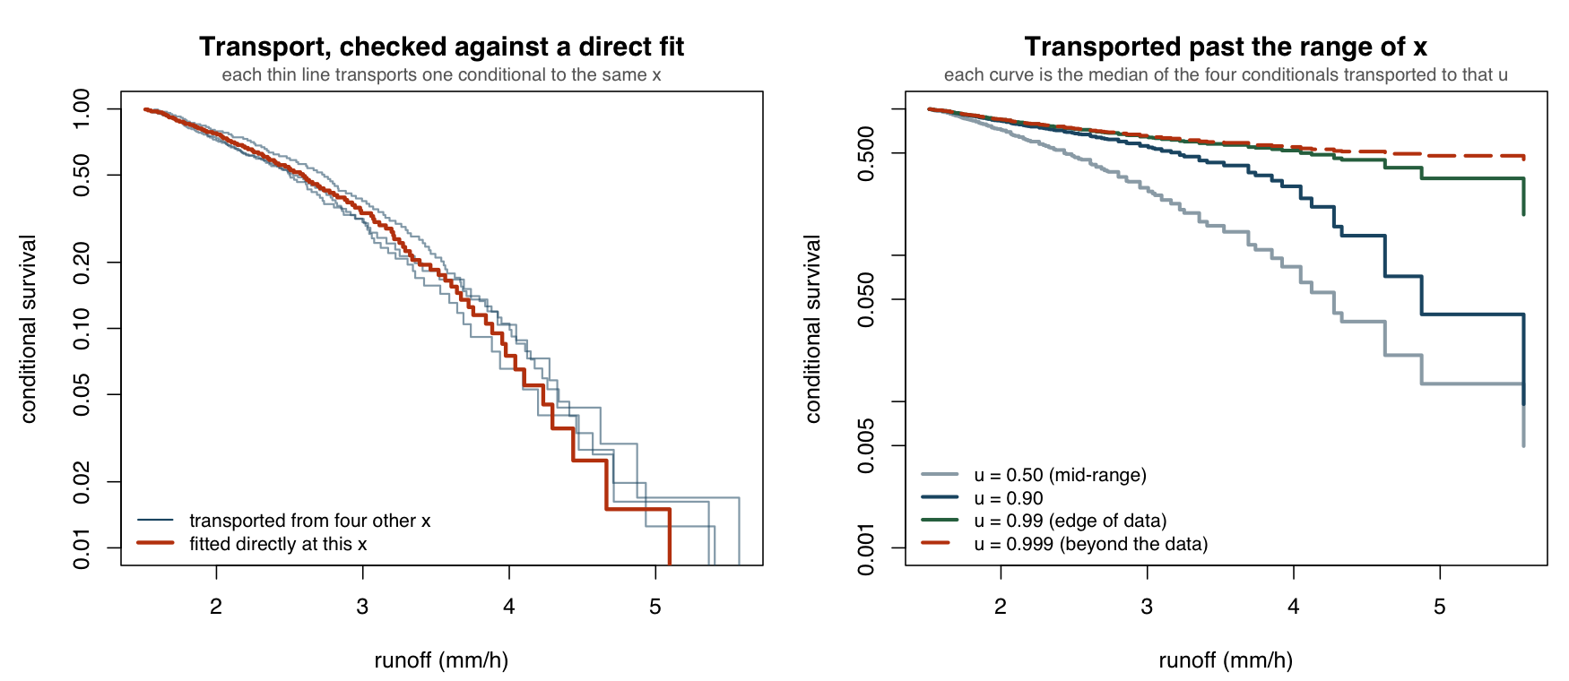
DISTRIBUTIONAL LEARNING
Challenge 2: copula transport
Like peaks-over-threshold: the copula carries learned distributions beyond the predictor space.
Left: it reproduces a conditional we can check. Right: transports pushed past the data. Still open: when does it give favourable estimates?
Notes:
One conditional plus the copula determines the whole family. Combine several by the median survival, not the mean, which would propagate the most extreme tail index again. So far the noise in distributional learning has struggled to beat estimating the distribution of runoff directly; that is what needs testing.

Slide 11
STATISTICAL DEVELOPMENTS
Three papers
One for each piece of the method, at different stages.
Nearly ready
Drafting
Inception
Smooth graft
Composite estimation
Copula transport
Purpose
Purpose
Purpose
When and how to hand off to a tail model.
Improved tail estimation.
Extending learned distributions outside the hull of x.
Status
Status
Status
Loose ends in the simulation section, then ready for final review.
The bones are in place, and a compelling simulation study is already there.
Inception. The need for it has been clearly demonstrated.
Notes:
Smooth graft comes first and stands on its own. Composite estimation builds on it. Copula transport addresses the distributional learning challenges on the previous two slides.

Slide 12
PROJECT PLAN
One year in, and on track
Phase 2 iterates between statistical development and data, for process insight.
 |  |  | Phase 1: MVP + software |  |  |  |  |  |  |  |  | Phase 2: Iterative development |  |  |  |  |  |  |  | Phase 3: Climate change
 |  |  | 1 | 2 | 3 | 4 | 5 | 6 | 7 | 8 | 9 | 10 | 11 | 12 | 13 | 14 | 15 | 16 | 17 | 18 | 19 | 20 | 21 | 22 | 23 | 24
Overhead | 1.1 | Project management | D1
 | 1.2 | Community
Data | 2.1 | Data compilation
 | 2.2 | Event granularity
Modelling | 3.1 | Min. viable model
 | 3.2 | Extremal learning
 | 3.3 | Climate change
Outputs | 4.1 | Software |  |  | D6 |  |  |  | D6
 | 4.2 | Flood map insights |  |  |  |  |  |  |  |  | D3 |  |  |  |  |  |  |  |  |  |  |  |  |  | D7
 | 4.3 | Writing |  |  |  |  |  |  | D5 |  |  |  |  |  |  |  | D2 |  | D4 |  |  |  |  |  |  | D8
Focus
Ongoing
D1–D8: deliverables
Today: month 12
Next up, as planned: data (2.1–2.2, months 12–13) brings in the snowpack driver; extremal learning (3.2, months 14–17) takes on copula transport.
Notes:
Month 1 is October 2025, so month 12 is September 2026. The point: phase 2 alternates statistical development with data and process insight, and the work is where the plan says it should be. The 'possible early end' line from the January replan (after month 7) is no longer shown.

